Slide 1
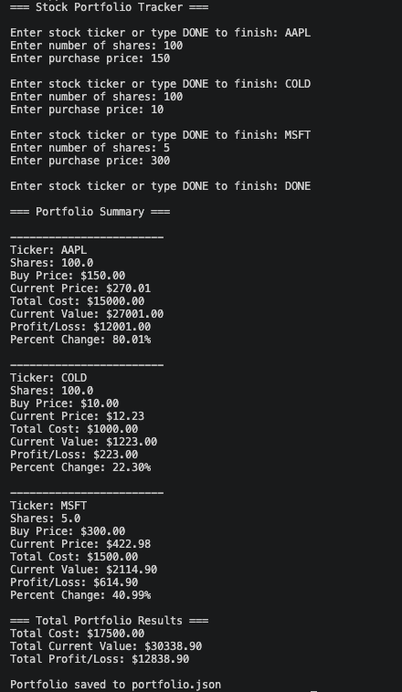

Smart Portfolio Tracker
By Adrian Pedersen
Track your stock performance in real time with a simple Python – based tool
Multiple stock tracking
- Real – time price lookup
Profit/loss Calculation
JSON data storage

